Slide 1
English Writing II
Week 11 Project 2 requirements and more

Slide 2
In today’s lesson
Review of Project 1
Requirements of Project 2
Sample reading – The Slur Article

Slide 3
Review of Project 1
A feature article (in-depth, vivid, non-fiction)
800-1000 words
Reliable data, opinions and hard facts
Use of analogy for exposition

Slide 4
Review of Project 1
Title
Structure and paragraphing
Analogy vs. metaphor vs. personification
Data interpretation

Slide 5
Sample titles
The Price of a Pandemic: Another shock to a vulnerable economy.
After the Storm: The flaws of our health-care system revealed.
A Crowned Killer
Stagnation and Vitality in Wuhan
A Pause in Winter
A Bad Start to 2020

Slide 6
Titles that need improvement
A Pandemic—COVID-19
We fought together
Can we stop the pandemic?
How can we stop the pandemic?

Slide 7
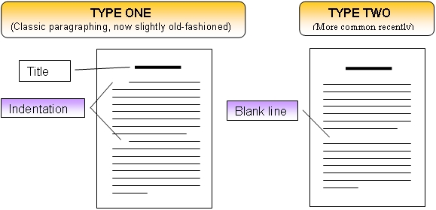
Paragraphing: indented vs. block format

Slide 8
Data interpretation
On February 19, the daily production of masks nationwide reached 110 million. If you run 110 million meters per hour, you are 90 times faster than the speed of sound.

Slide 9
Data interpretation
The droplets are tiny, so small that 100 of them could fit in the point of a ball pen. But just one of these tiny things can contain millions of coronavirus invaders, the same order of magnitude used to describe the population of Wuhan.

Slide 10
Vivid description
She was suddenly aware of her racing heartbeat when their eyes met. Clutching tightly at her shopping bags, the lady zigzagged her way out of the narrow aisle between shelves to eschew the man. They both underwent the undesirable encounter with bated breath. What triggers the seemingly implausible reaction is fear rather than affection.

Slide 11
Vivid description
Taxi drivers also received a severe blow. Mrs. Liu, wife of a taxi driver, complained that her husband persevered in “winning the bread” despite the virus, but when he worked for 14 hours and called it a day, he even suffered a 100-yuan loss. Seen from the sky above one of the villages in the city, hundreds of cabs were in a line of 400 meters, snaking around the parking lot, which could encircle a sports field.

Slide 12
The enemy troops, to be exact, the crown-like viruses, were already hidden in every corner of the city. They clung to the air or respiratory droplets and leaned against or squatted on handrails, ready to raid. As people breathed, talked to someone, or touched handrails, the troops acted. They directly rushed into people’s nose or mouth. Or they landed on the hands first and struck when people rubbed their eyes. After the successful invasion, the troops sneaked and integrated into cells, then proliferating. In 2-14 days, people might cough and have a fever. This was the enemy troops waving flags and sounding the alarm to people—they had been infected.

Slide 13
Requirements for Project 2
Argumentation + (exposition, narration and description)
Factual evidence, supporting details & real-life examples
Specific technique: COUNTERARGUMENT +
800-1000 words
DDL: May 18th

Slide 14


A sample-reading (20 min)
The Slur I Never Expected to Hear in 2020.docx

Slide 15
Stepwise argumentation
Stereotypes (about China)
Panic and anti-Asian incidents
Xenophobia
Anti-Asian racism
Indiscriminate racism
The model-minority myth (a lie)
White-supremacy (for minorities in general)

Slide 16
Supporting evidence
Real-life examples
→ Chronological order
→ Degrees of severity and scope
Historical incidents
Personal experiences

Slide 17
Requirements for Project 2
Argumentation + (exposition, narration and description)
Factual evidence, supporting details & real-life examples
Specific technique: COUNTERARGUMENT +
800-1000 words
DDL: May 20th

